Slide 1

Four OOP fundamental concepts:
Abstraction
Encapsulation

Slide 2
Inheritance
class Person{
String name;
String getName(){
return name;
}
}
superclass
Student inherits from Person
Person
class Student extends Person{
String school;
void getSchool(){
return school;
}
}
Student
Subclass inherits members of the superclass
subclass
Student s = new Student();
String name = s.getName();

Slide 3
specialization
generalization
superclass : subclass
parent class : child class
base class : derived/extended class
Student
Person
Teacher
AdminStaff
is a

Slide 4
Inheritance tree/hierarchy
Student
UGStudent
Person
Teacher
NGStudent
NGStudent
AdminStaff
PGStudent

Slide 5
Multiple Inheritance
Java: single class hierarchy
Object
HelloWorld
Square
…
…
FilledSquare
C++: Many class hierarchies

Slide 6
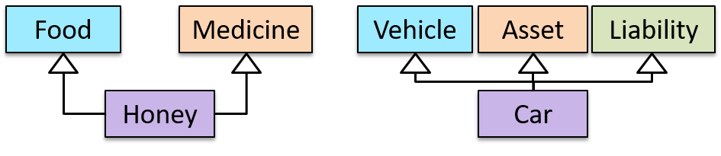
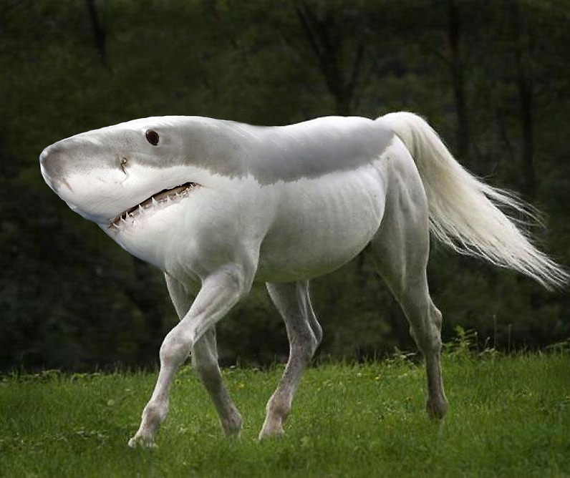
Multiple Inheritance

Slide 7
Overriding
class Person{
String name;
String getName(){
return name;
}
}
superclass
Person
class Student extends Person{
String school;
void getSchool(){
return school;
}
@Override
String getName(){
return “student:” + name;
}
}
Student
subclass
Subclass can override the superclass behavior
Optional annotation

Slide 8
Overriding
String getName(){
return “student:” + name;
}
A sub-class changes the behavior inherited from the parent class by re-implementing the method
String getName(String salutation){
return salutation + name;
}
Method with same name but different type signature.
add(int x, int y);
add(double x, double y);
Overloading

Slide 9
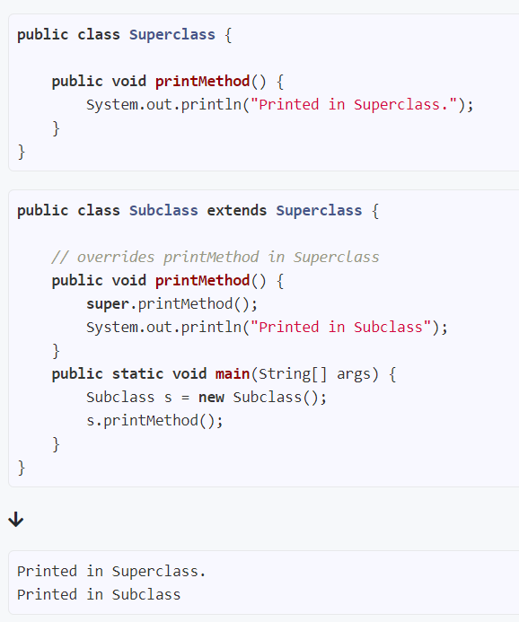
Accessing methods of the super class

Slide 10
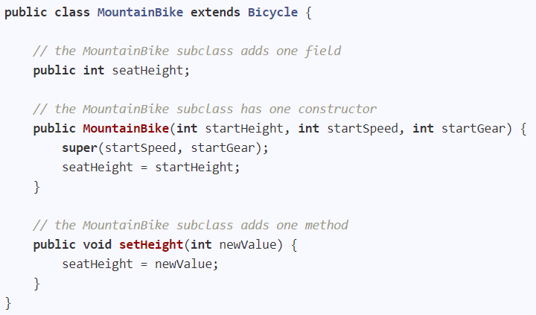
Constructor of the sub class

Slide 11
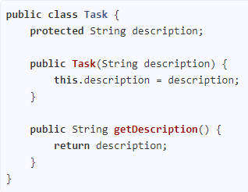
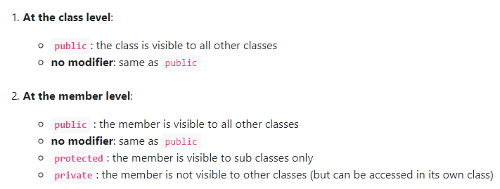
Access modifiers (when no packages)

Slide 12
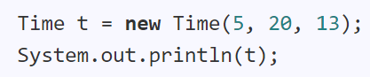

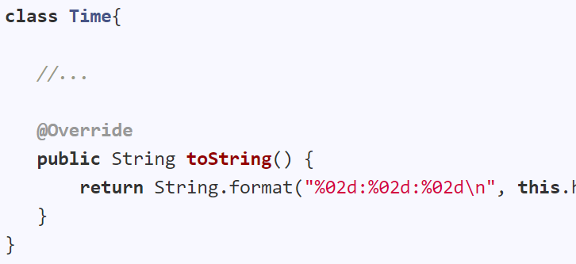

Object class
Overriding the toString method inherited from Object class
Optional

Slide 13
Four OOP fundamental concepts:
Abstraction
Encapsulation
Inheritance

Slide 14
Substitutability
Every instance of a subclass is an instance of the superclass, but not vice-versa.
Staff
AcademicStaff
AdminStaff
AcademicStaff is a Staff
Staff staff = new AcademicStaff (); // OK
Staff may or may not be a AcademicStaff
Staff staff;
...
AcademicStaff academicStaff = staff; // Not OK

Slide 15
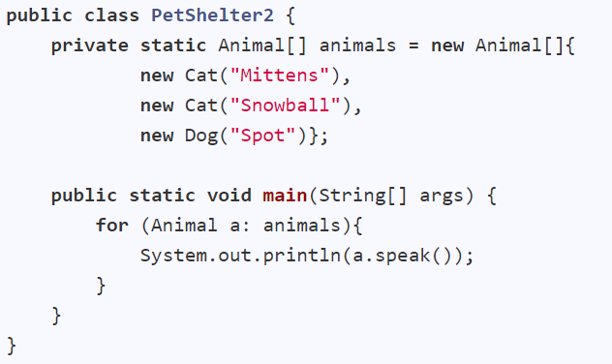
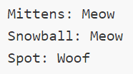
Polymorphism
Treat one type as another and still get the behavior of the actual object
Animal
Cat
Dog
This method is in the Animal class but overridden in the Cat and Dog classes

Slide 16

Polymorphism
Ability to treat different types as same type and yet get different behavior
Ability to be accepted as a different type but maintain own behavior

Slide 17
Four OOP fundamental concepts:
Abstraction
Encapsulation
Inheritance
Polymorphism

Slide 18

My students can be only UG, PG, EXCHG
public enum StudentType {
UG, PG,
EXCHG
}
StudentType.UG;
Use a variable lor
Enumerations

